Slide 1
Web and Mobile Development Overview
Creating the web experiences

Slide 2
GIT
Version control system

Slide 3
SUMMARY
Git is the most widely used version control system for tracking and managing code changes.
Core Benefits:
- Save snapshots of your project at any time.
- Compare current code to earlier versions.
- Revert to previous states when needed.
-Collaborate safely without overwriting work.
Key Concepts:
- .gitignore: Exclude sensitive or unnecessary files from the repository.
- Local repository: Where you track and commit changes on your machine.
Remote repository: A shared version of your code on platforms like GitHub.

Slide 4
SUMMARY
Basic Workflow:
- Create a GitHub account.
- Install Git locally.
- Initialize a repository.
- Add and commit changes.
- Push commits to GitHub.
- View history and roll back if needed.

Slide 5
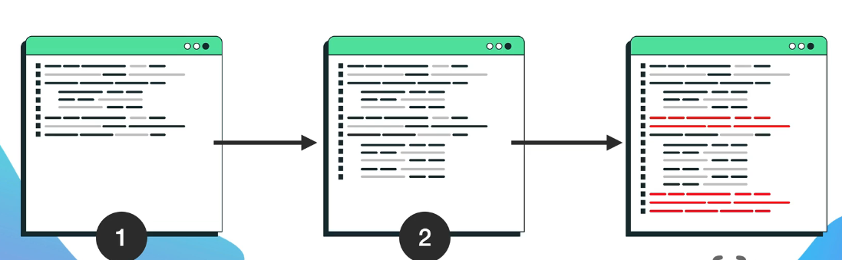
GIT
- Git is the most popular version control system, which allows you to track changes to your code and make it easier to work with your team - Git allows you to revert to any previous version!
Git uses snapshots of your code, so you can: - Compare the current code with old versions - Revert to any previous version - Work with a team without worrying about data loss.
www.github.com
Notes:
Teacher Notes:
Explain what version control is and why it matters for both solo and team projects.
Demonstrate the “snapshot” model: how Git stores commits as a directed graph of snapshots, not diffs.
Show a quick comparison of editing a file locally vs. committing changes to illustrate safe experimentation.
Resources:
Official Git Documentation – What is Version Control?
GitHub Learning Lab – Introduction to Git
Additional Reading:
Pro Git by Scott Chacon and Ben Straub (Chapters 1–2)
Version Control with Git by Jon Loeliger and Matthew McCullough

Slide 6

EXERCISE
- Create an account on GitHub - Install git on your computer
www.github.com
Notes:
Teacher Notes:
Walk students through creating a free GitHub account and setting up two‑factor authentication.
Demonstrate installing Git on Windows/Mac/Linux and configuring git config --global user.name and user.email.
Explain the importance of SSH vs. HTTPS for remote operations and show how to generate an SSH key.
Resources:
GitHub Docs – Set up Git
Atlassian – Git Installation Guide
Additional Reading:
Git Pocket Guide by Richard E. Silverman
Learning Git by Anna Debenham

Slide 7
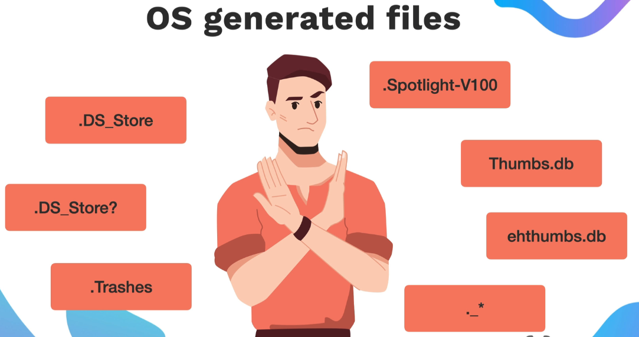
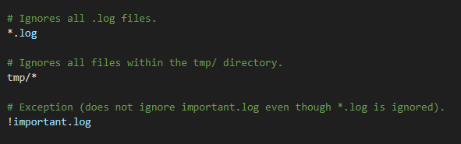
GIT - .GITIGNORE
We use it to prevent certain files from being added to the Git repository. This is extremely important to protect sensitive data (API keys, passwords, private settings) and avoid unnecessary sharing of local settings with the rest of the team
www.appbrewery.com
Notes:
Teacher Notes:
Describe how .gitignore uses glob patterns to exclude files (e.g., node_modules/, .env, *.log).
Show examples: adding a .env file to protect API keys, ignoring IDE/editor configs.
Demonstrate using gitignore.io to generate language‑specific templates.
Resources:
Git SCM – Ignoring Files
gitignore.io – Generate .gitignore templates

Slide 8
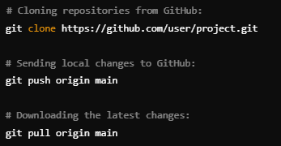
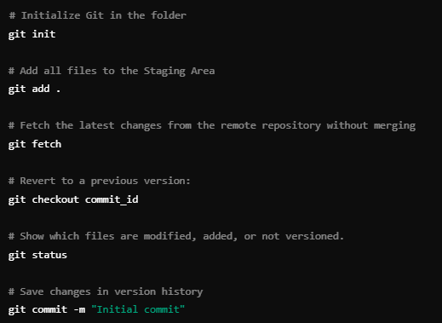
GIT - COMMANDS
Notes:
Teacher Notes:
Cover the workflow: git init, git status, git add, git commit.
Show history exploration with git log and comparison with git diff.
Introduce branching: git branch, git checkout -b, merging with git merge.
Explain fetch vs. pull, and pushing changes: git push, git pull.
Resources:
Atlassian – Git Command Reference
Git SCM – Git Cheat Sheet
Additional Reading:
Git Pocket Guide by Richard E. Silverman
Pro Git by Scott Chacon and Ben Straub (Chapter 3, “Git Branching”)

Slide 9

GIT - EXERCISE
- Create a local Git repository - Add and commit changes - View commit history - Revert to previous versions - Work with a remote repository on GitHub
www.fork.com
Notes:
Teacher Notes:
Live‑demo creating a local repository (git init), making several commits, and using git log/git checkout to revert to a previous state.
Walk through connecting to GitHub: git remote add origin <URL> and git push -u origin main.
Show how to clone an existing repository (git clone) and contribute via feature branches and pull requests.
• Exercise estimation time: 20 min / individual
Resources:
GitHub Docs – Hello World Tutorial
Git SCM – Cloning a Repository
Additional Reading:
Version Control with Git by Jon Loeliger and Matthew McCullough
Git Magic by Ben Lynn (free online book)

Slide 10
GitHub Docs – Hello World Tutorial
Git SCM – Cloning a Repository
Version Control with Git by Jon Loeliger and Matthew McCullough
Git Magic by Ben Lynn (free online book)

Slide 11
https://docs.github.com/en/get-started/quickstart/set-up-git
https://www.atlassian.com/git/tutorials/install-git
https://git-scm.com/docs/gitignore
https://www.toptal.com/developers/gitignore
https://www.atlassian.com/git/tutorials/git-basics
https://education.github.com/git-cheat-sheet-education.pdf
https://docs.github.com/en/get-started/quickstart/hello-world
https://git-scm.com/book/en/v2/Git-Basics-Getting-a-Git-Repository#_cloning_an_existing_repository

Slide 12
HTML
Basic of the HTML files

Slide 13
SUMMARY
HTML Overview
HTML is the markup language that defines the structure of web pages (headings, paragraphs, lists, links, images).
Websites require an HTML file; CSS and JavaScript are optional layers (style and interactivity).
Core HTML Elements
Titles
Define page titles in the browser.
Paragraphs
Use <p> to separate text into blocks and improve readability and accessibility.
Lists
Ordered lists (<ol>)
Unordered lists (<ul>)
Links (Anchors)
Use <a href=""> to create hyperlinks.
Images
<img src="" alt=""> adds images.
"alt" attribute improves accessibility and shows fallback text.

Slide 14
SUMMARY
Attributes
Add extra information inside tags (e.g., href, src, alt).
Paths
Absolute paths point to full URLs.
Relative paths refer to locations in your project.
HTML Multipage Navigation
Link pages together to build multipage websites.
Use ./ for current directory references.
Best Practices
Always close tags.
Keep indentation clear and consistent.
Use VS Code Live Preview for instant feedback.
Validate HTML to ensure compatibility.

Slide 15

HOW WEBSITES WORK
- HTML (Content) - The structure of a web page (text, images, buttons). - CSS (Styles) - Defines the layout (colors, fonts, arrangement of elements). - JavaScript (Functionality)- Adds interactivity (click events, animations, form validation). The browser interprets and displays these files to display the web page.
www.appbrewery.com
Notes:
• Emphasize that HTML is mandatory for any web page and serves as the structural foundation on which CSS and JavaScript build design and interactivity. • Open with a discussion on how browsers parse these three components to render a complete webpage. • Consider demonstrating a simple “Hello World” HTML file in Visual Studio Code with Live Preview.
Resources: • https://developer.mozilla.org/en-US/docs/Web/HTML for a thorough introduction. Additional Reading: • HTML and CSS: Design and Build Websites by Jon Duckett • Learning Web Design: A Beginner’s Guide to HTML, CSS, JavaScript, and Web Graphics by Jennifer Niederst Robbins

Slide 16
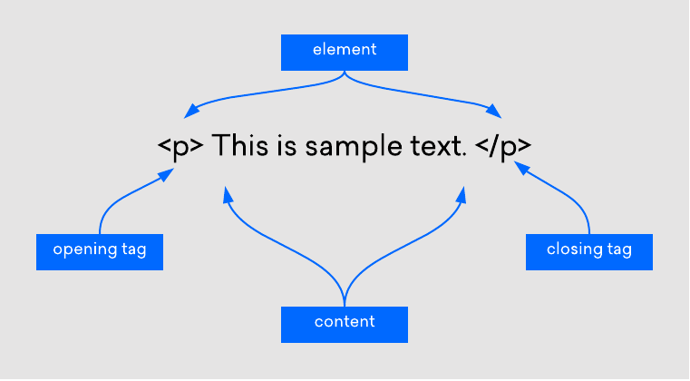
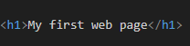
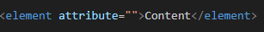
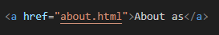
HTML
- Unlike CSS or JavaScript, a website can only exist with an HTML file - Markup language: Similar to editorial markup in manuscripts (bold, underline, etc.) - HTML uses tags to structure content
www.w3schools..com
Notes:
Teacher Notes: • Clarify that while CSS and JavaScript enhance user experience, HTML is indispensable for content. • Use side-by-side examples to show a page with only HTML versus one with additional CSS and JavaScript. • Discuss how changes in each part (structure, style, behavior) affect the final rendered page.
Resources: • MDN – Introduction to HTML - https://developer.mozilla.org/en-US/docs/Learn_web_development/Core/Structuring_content/Basic_HTML_syntax Additional Reading: • HTML and CSS: Visual QuickStart Guide by Elizabeth Castro

Slide 17
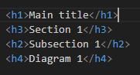
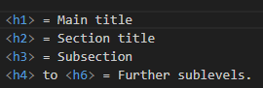
HTML TITLES

Slide 18

EXERCISE
Install in VS code and use the Live Preview plugin to view changes in real-time Recreate image
Notes:
Teacher Notes: • Demonstrate setting up VS Code with the Live Server extension to observe changes instantly. • Explain the role of the <title> tag not only in SEO but also in user navigation (browser tabs). • Walk through creating an HTML document that uses a proper <head> section including a title.
• Exercise estimation time: 20 min / individual
Resources: • MDN – Using the HTML <title> element
Code - https://github.com/dinoDuvnjak/CTK/tree/main/SHIFT4IT/html-introduction/2.6-html-final

Slide 19
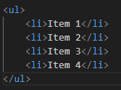
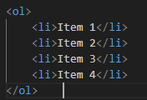
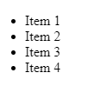
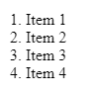
HTML LISTS
Unordered list
Ordered list
It is used when the order is not important (e.g. shopping list).
It is used when the order is not important (e.g. shopping list).
Notes:
Teacher Notes: • Stress the importance of correct syntax and indentation for both maintenance and readability. • Conduct a live coding session to show how HTML lists should be structured and highlight typical errors.
Resources: • MDN – HTML Lists • W3Schools – HTML Lists
Additional Reading: • Learning Web Design by Jennifer Niederst Robbins

Slide 20
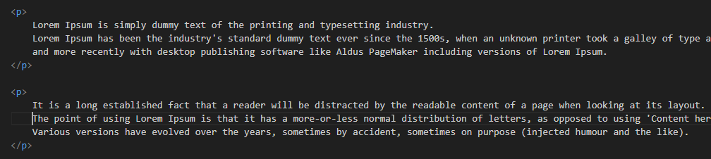
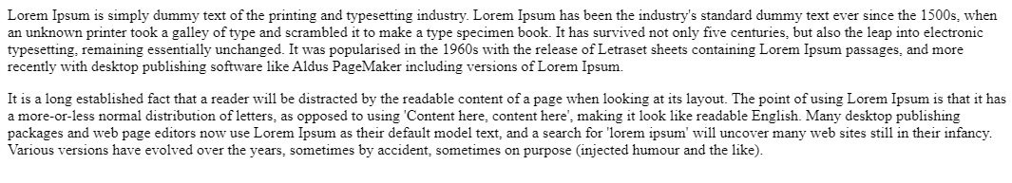
HTML PARAGRAF
The paragraph element<p> is used to format the text into separate paragraphs - Without <p> tags, all the text would be in one long block. - It separates the text and adds visual spacing between paragraphs. - Screen readers use <p> labels to help visually impaired users navigate through text
Notes:
Teacher Notes: • Illustrate how omitting <p> tags can lead to cluttered content and poor accessibility. • Discuss best practices in creating readable content that both sighted users and screen readers can navigate easily.
Resources: • MDN – HTML Paragraphs
Additional Reading: • Accessibility for Everyone by Laura Kalbag

Slide 21
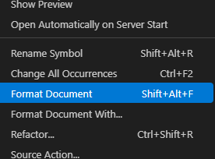
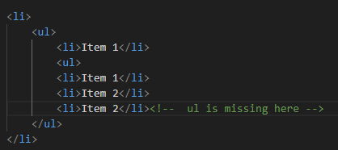
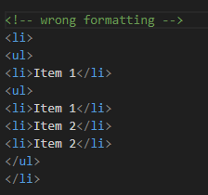
HTML LISTS
Common mistakes to avoid Forgetting to close tags (</ul> or </ol>).
Incorrect code indentation, making it difficult to read and maintain.
Setting </li> before closing a nested list instead of after it.

Slide 22
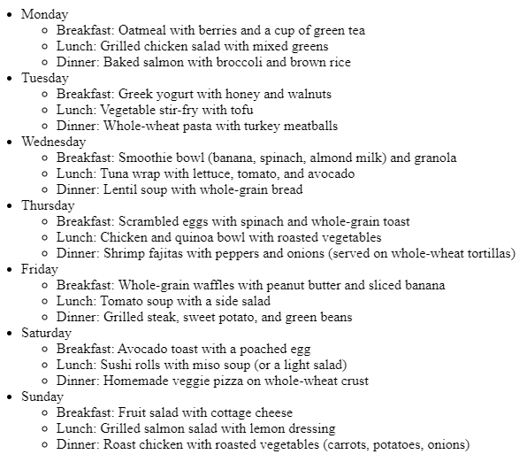
EXERCISE
Recreate image in html code
Notes:
Teacher Notes: • Guide students through the creation of nested lists and using proper list tags (<ul>, <ol>, <li>). • Offer step-by-step instructions while projecting the code and its rendered output.
• Exercise estimation time: 20 min / individual
Resources: • MDN – HTML Lists • W3Schools – HTML Lists
Code - https://github.com/dinoDuvnjak/CTK/tree/main/SHIFT4IT/html-introduction/2.2-html-list

Slide 23
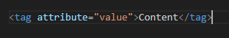
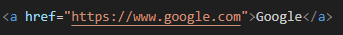
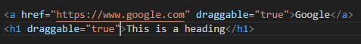
HTML ATTRIBUTES
HTML elements can have attributes that add additional information about the element. Attributes are located inside the opening tag
Specific
Global
Notes:
Teacher Notes: • Explain that attributes add metadata or control behavior for HTML elements (e.g., href, src, alt). • Discuss how some attributes are available for all tags (global attributes) while others are tag-specific. • Encourage students to explore the provided link for interactive examples.
Resources: • W3Schools – HTML Attributes • MDN – HTML Standard Attributes
Additional Reading: • HTML5 in Easy Steps by Mike McGrath

Slide 24
HTML ANCHOR
- Allows the creation of hyperlinks - The href attribute specifies the URL to which the link leads.
- Attributes are located inside the opening tag - Without the href attribute, the link is not active
Notes:
Teacher Notes: • Demonstrate the creation of both internal and external links using relative and absolute URLs. • Highlight the importance of using descriptive link text for both SEO and accessibility.
Resources: • MDN – The HTML Anchor Element • W3Schools – HTML Links

Slide 25
HTML IMAGE
- Allows you to add images to our websites - The src attribute (source) defines the source of the image <img> It doesn't have a closing tag, because it's a void element.
Why is alt important? - Helps blind and visually impaired people understand the content of the image. - When an image can't load, alt text is displayed.
Notes:
Teacher Notes: • Emphasize best practices for image embedding and the critical role of the alt attribute in accessibility. • Show examples of responsive images and discuss troubleshooting steps if images do not load.
Resources: • MDN – The HTML <img> Element • W3Schools – HTML Images

Slide 26
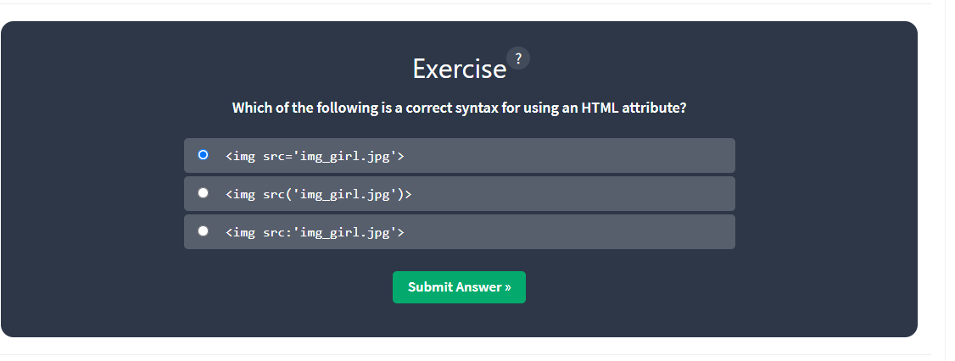

EXERCISE
- Go to ://www.w3schools.com/html/html_attributes.asp and practice the quiz
Notes:
Teacher Notes: • Briefly review common pitfalls with attributes in class after the exercise. • Encourage students to modify attributes and observe changes in real-time using a code editor.
• Exercise estimation time: 15 min / individual
Resources: • W3Schools – HTML Attributes

Slide 27
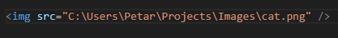
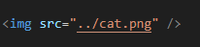
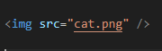
HTML PATHS
- A file path is a unique location on your computer where a specific file or folder is located. - We can compare it to a real-world address
Absolute path
Relative path
One level up
Current directory
Notes:
Teacher Notes: • Use examples to illustrate the differences between absolute and relative paths. • Demonstrate navigation using relative path syntax in linking files locally.
Resources: • MDN – URLs, URIs, and URNs • W3Schools – How Paths Work
Additional Reading: • Responsive Web Design with HTML5 and CSS3 by Ben Frain

Slide 28
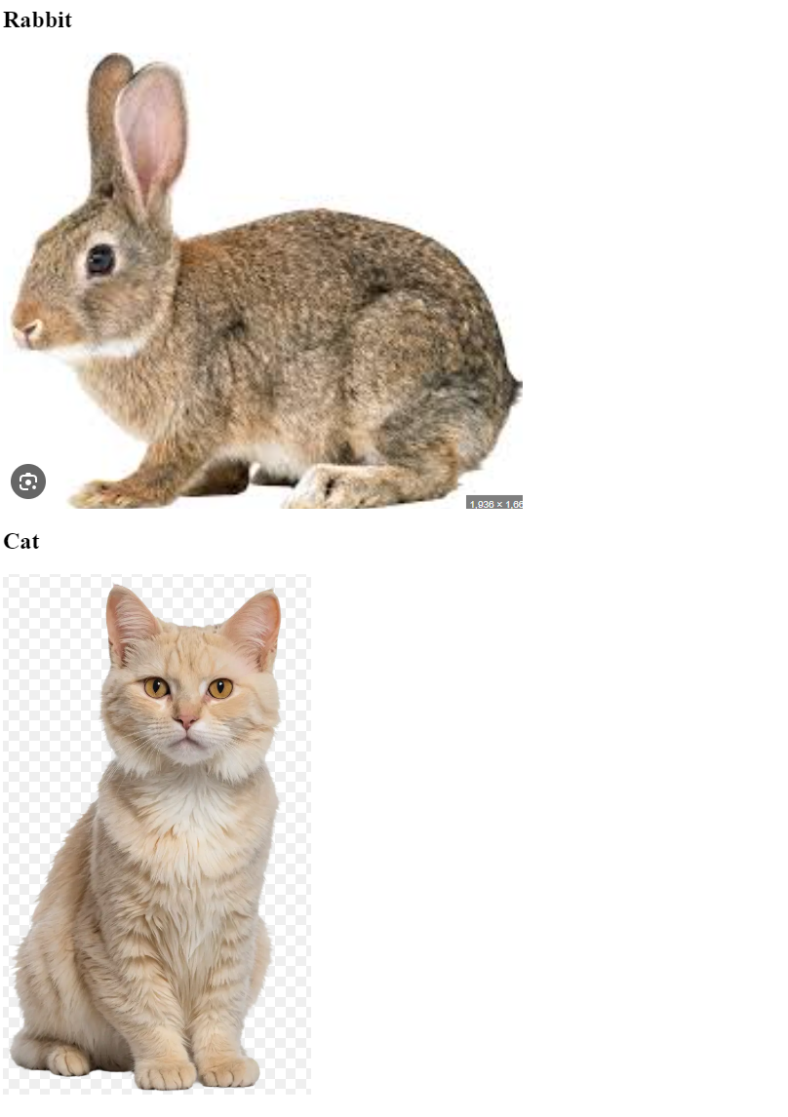
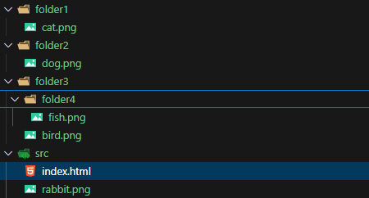

EXERCISE
- Download 2.4-html-image-link project and connect the images in html file
- Replicate the image result
Notes:
Teacher Notes: • Walk through the process of linking local images and discuss troubleshooting common issues like incorrect file paths or typos. • Offer to review a sample project live, explaining the impact of each attribute used in the <img> tag.
• Exercise estimation time: 25 min / individual
Resources: • W3Schools – HTML Images Tutorial • MDN – The HTML <img> Element
Code - https://github.com/dinoDuvnjak/CTK/tree/main/SHIFT4IT/html-introduction/2.4-html-image-link

Slide 29
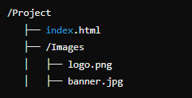
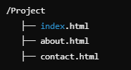
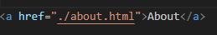
HTML MULTIPAGE
- To allow users to navigate through the site, we need to link pages using hyperlinks.
One page website
Multipage website
How to link a page
- Allows you to add images to our websites - ./ means "search in the current directory". - By clicking on the link, we will be taken to the "About Us" page.
Notes:
Teacher Notes: • Demonstrate linking multiple HTML files to create a navigable website. • Emphasize the importance of organizing files and folders for maintainability. • Use a live coding example to show how clicking a link opens a new page.
Resources: • MDN – Linking to Other Resources • W3Schools – HTML Links
Additional Reading: • Head First HTML and CSS by Elisabeth Robson and Eric Freeman

Slide 30

EXERCISE
Create a multi-page site - Clicking on the image takes us to the about us page - Click on Contact me, take us to the contact page
Notes:
Teacher Notes: • Provide clear guidelines and a rubric for the exercise. • Encourage students to test all navigation links to ensure there are no broken paths. • Review best practices for organizing and maintaining consistent navigation across pages.
Resources: • Codecademy – Building Multi-Page Websites (project-based learning) • MDN – Hyperlink Fundamentals
Code - https://github.com/dinoDuvnjak/CTK/tree/main/SHIFT4IT/html-introduction/2.5-html-multipage-website

Slide 31
EXERCISE
Objective
Create a basic HTML skeleton for CraftEase, a DIY Workshop Management System designed for home improvement retailers. The goal is to create a foundation that will later be enhanced with CSS and JavaScript to provide a complete digital service for managing DIY workshop registrations, project tutorials, and tool/material availability tracking. Once completed, upload the project to GitHub.
Project Background
Header with site branding and description
Navigation menu for different system sections
Workshop Registration Form for new participants
Participant Management Table showing registered customers
Upcoming Workshops Section displaying scheduled events
Tool & Material Inventory Table for availability tracking
Notes:
Teacher Notes: • Clearly lay out project requirements and milestones. • Provide a sample file structure and tips on ensuring clean, indented code. • Encourage peer reviews and code sharing via GitHub to promote collaborative learning. • Highlight the importance of version control in web development.
• Exercise estimation time: 30 min / individual
Resources: • GitHub Guides – Hello World for an introduction to Git and GitHub • FreeCodeCamp – HTML Project Tutorials for project-based learning
Code- https://github.com/dinoDuvnjak/CTK/tree/main/SHIFT4IT/html-introduction/2.6-html-final

Slide 32
EXERCISE
Content Requirements
Add at least four sample workshop participants with realistic data
Include five different workshop types (woodworking, electrical, plumbing, tile installation, painting)
Show two upcoming workshop cards with complete details
Display four inventory items with stock levels and availability status
Use appropriate form elements (text inputs, selects, textarea, email, tel, number)
Deliverables
HTML file named index.html with complete workshop management system structure
README.md file explaining the project purpose and structure
GitHub repository with the complete project uploaded
Ensure the HTML validates and displays properly in modern browsers
Submission
Upload your completed project to GitHub with:
Repository name: craftease-workshop-management
Include all required files (HTML, README.md)
Notes:
Teacher Notes: • Clearly lay out project requirements and milestones. • Provide a sample file structure and tips on ensuring clean, indented code. • Encourage peer reviews and code sharing via GitHub to promote collaborative learning. • Highlight the importance of version control in web development.
• Exercise estimation time: 30 min / individual
Resources: • GitHub Guides – Hello World for an introduction to Git and GitHub • FreeCodeCamp – HTML Project Tutorials for project-based learning
Code- https://github.com/dinoDuvnjak/CTK/tree/main/SHIFT4IT/html-introduction/2.6-html-final

Slide 33
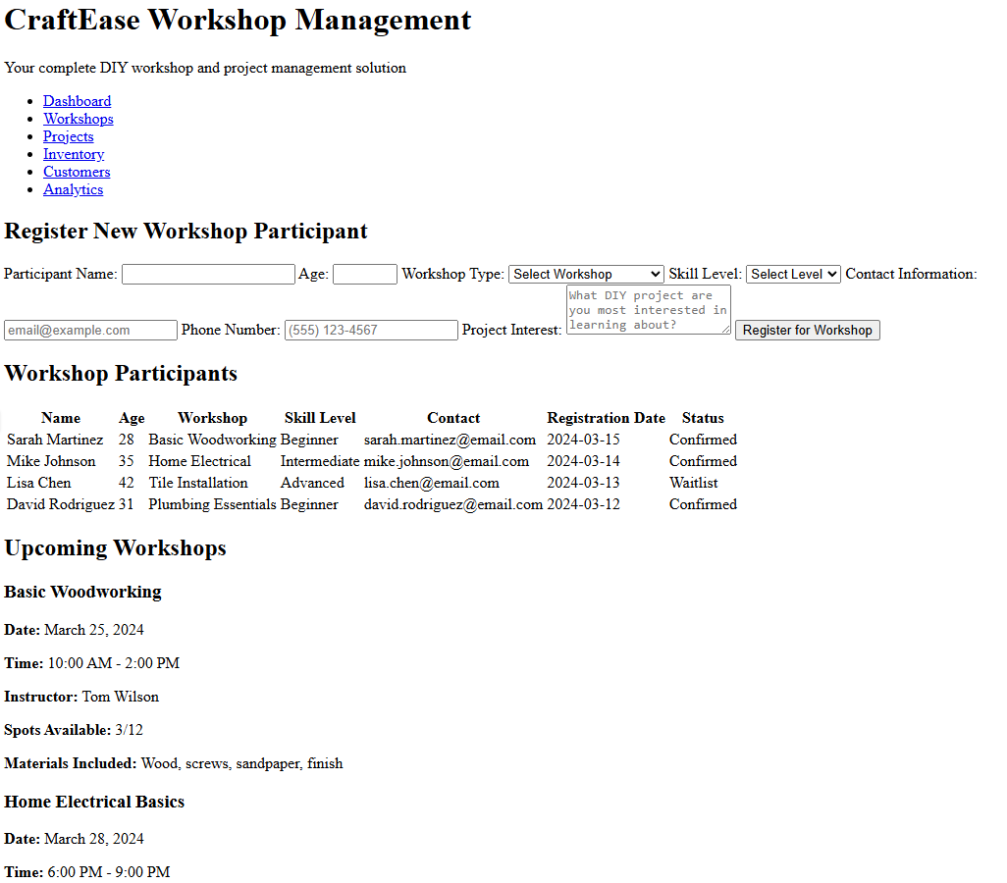
HTML – FINAL EXERCISE
Notes:
Teacher Notes: • Clearly lay out project requirements and milestones. • Provide a sample file structure and tips on ensuring clean, indented code. • Encourage peer reviews and code sharing via GitHub to promote collaborative learning. • Highlight the importance of version control in web development.
Resources: • GitHub Guides – Hello World for an introduction to Git and GitHub • FreeCodeCamp – HTML Project Tutorials for project-based learning
Code- https://github.com/dinoDuvnjak/CTK/tree/main/SHIFT4IT/html-introduction/2.6-html-final

Slide 34
HTML and CSS: Design and Build Websites by Jon Duckett - Learning Web Design: A Beginner’s Guide to HTML, CSS, JavaScript, and Web Graphics by Jennifer Niederst Robbins
Responsive Web Design with HTML5 and CSS3 by Ben Frain
Learning Web Design by Jennifer Niederst Robbins
HTML and CSS: Visual QuickStart Guide by Elizabeth Castro
- Head First HTML and CSS by Elisabeth Robson and Eric Freeman

Slide 35
https://developer.mozilla.org/en-US/docs/Web/HTML
https://developer.mozilla.org/en-US/docs/Learn_web_development/Core/Structuring_content/Basic_HTML_syntax
https://developer.mozilla.org/en-US/docs/Web/HTML/Reference/Elements/title
https://www.google.com/search?q=MDN+%E2%80%93+HTML+Paragraphs&ie=UTF-8
https://developer.mozilla.org/en-US/docs/Web/HTML/Reference/Elements/p
https://developer.mozilla.org/en-US/docs/Learn_web_development/Core/Structuring_content/Lists
https://www.w3schools.com/html/html_attributes.asp
https://developer.mozilla.org/en-US/docs/Learn_web_development/Core/Structuring_content/Creating_links
https://developer.mozilla.org/en-US/docs/Web/HTML/Reference/Elements/img
https://developer.mozilla.org/en-US/docs/Web/HTML/Reference/Elements/link
https://developer.mozilla.org/en-US/docs/Learn_web_development/Core/Structuring_content/Creating_links

Slide 36
CSS
Website stylization

Slide 37
SUMMARY
CSS Overview
CSS styles HTML (colors, fonts, layout, animations).
"Cascading" = rules go from general to specific.
Ways to Add CSS
Inline CSS - inside element tag (not recommended).
Internal CSS - <style> tag in HTML.
External CSS - separate .css file (best practice).
Selectors
Element - p, h1
Class - .classname
ID - #idname
Attribute - [type="text"]
Universal - *
Box Model
Content -> Padding -> Border -> Margin

Slide 38
SUMMARY
Cascade and Specificity
Inline > ID > Class > Element
!important overrides everything.
Positioning
Static - default
Relative - offset from normal
Absolute - positioned to ancestor
Fixed - stays on screen
Z-index - layer order
Display
Block - full width
Inline - content width
Inline-block - inline + block features
None - hide element

Slide 39
SUMMARY
Float
Wrap text around elements
Avoid for complex layouts
Responsive Design
Flexbox - flexible rows/columns
Grid - complex 2D layouts
Frameworks - Bootstrap, Tailwind, Bulma

Slide 40
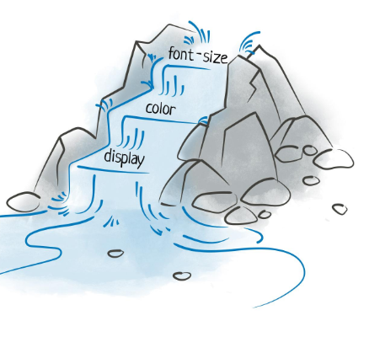
CSS
CSS is an acronym for Cascading Style Sheets. What do you mean by "cascading"? Let's imagine a waterfall – water flows from one level to another. Also, CSS styles are applied from the most general to the most specific rules. This allows for design control and flexibility. Tables).
Notes:
Teacher Notes:
Explain the meaning of “Cascading” via the waterfall analogy—styles flow from general to specific rules.
Emphasize that CSS separates presentation from content, improving maintainability.
Resources:
MDN – What is CSS?
W3Schools – CSS Introduction
Additional Reading:
CSS: The Definitive Guide by Eric A. Meyer
Learning Web Design by Jennifer Niederst Robbins

Slide 41
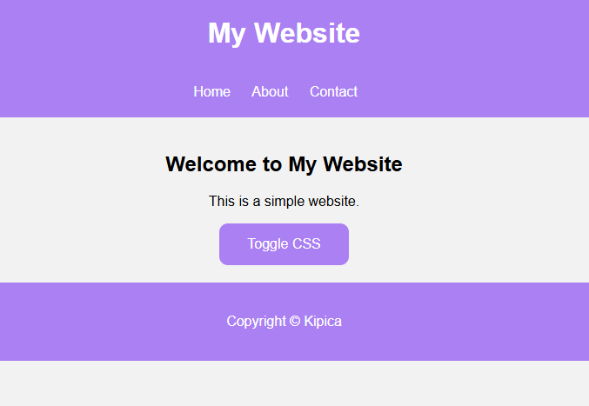
CSS
CSS transforms plain HTML into an attractive design! - No CSS – sites are plain, black and white, and boring.
- With CSS – we can change: - Colors - Fonts - Background images Arrangement and size of elements Animations and effects
https://dinoduvnjak.github.io/css-toogle/
Notes:
Teacher Notes:
Show a plain HTML page and then layer on CSS incrementally (colors, fonts, layout).
Live‑code a minimal HTML page and toggle CSS on/off to illustrate impact.
Site - https://dinoduvnjak.github.io/css-toogle/

Slide 42
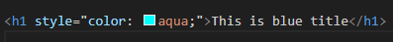
CSS-INLINE CSS
Suitable when you want to quickly change the style of only one element
Problem with Inline CSS - Difficult to maintain - Not practical for multiple elements - It is not used often, except for quick changes
Notes:
Teacher Notes:
Inline CSS (Slide 3): Demonstrate <p style="color:red">…</p> and discuss why it’s only for quick tweaks.
Internal CSS (Slide 4): Show a <style> block in <head>; note duplication across pages.
External CSS (Slide 5): Create a separate .css file, link via <link>; explain caching benefits.
Resources:
MDN – Using Inline Styles
MDN – The <style> Element
MDN – The <link> Element for CSS

Slide 43
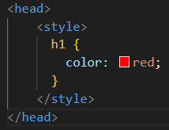
CSS-INTERNAL CSS
Can be used to style the entire page
Problem with Inline CSS - If the site has multiple HTML pages, you have to repeat the styles in each file

Slide 44
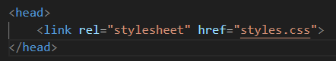
CSS-EXTERNAL CSS
- Easier maintenance – all styles in one place - Multiple pages use the same CSS file. - Faster loading – browsers cache CSS
Notes:
Teacher Notes:
Guide students step‑by‑step: create inline.html, internal.html, external.html.
Encourage side‑by‑side file explorer + browser view for instant feedback.
Resources:
Codecademy – Learn CSS

Slide 45
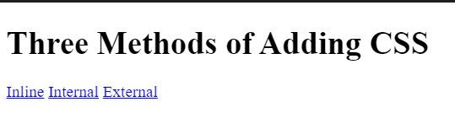
EXERCISE
- Objective: Create a page with three links that change the color of the text using all three methods. - Steps: - Create index.html - Add inline.html, internal.html and external.html - Uses inline, internal, and external CSS to style titles
Notes:
Teacher Notes:
Guide students step‑by‑step: create inline.html, internal.html, external.html.
Encourage side‑by‑side file explorer + browser view for instant feedback.
Exercise estimation time: 25 min / individual
Resources:
Codecademy – Learn CSS
CODE - https://github.com/dinoDuvnjak/CTK/tree/main/SHIFT4IT/css-introduction/3.1-methods

Slide 46
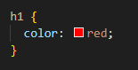
CSS-ELEMENT SELECTORS
CSS selectors allow us to select HTML elements and apply styles to them
Apply the style to all h1 elements and HTML files
Caution! Element selectors apply a style to all HTML elements of that type
Notes:
Teacher Notes:
Element Selectors: Style all <p>, <h1>, etc.
Class Selectors: Reuse .highlight across elements.
ID Selectors: Use #main-header once; discuss specificity cost.
Attribute Selectors: Target [type="text"] inputs.
Universal Selector: Use * { margin:0 } as a reset.

Slide 47
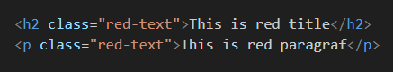
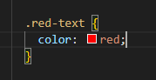
CSS-CLASS SELECTORS
CSS selectors allow us to select HTML elements and apply styles to them
Classes are used to group multiple elements that share the same style You can add the same class to multiple elements!

Slide 48
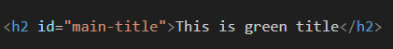
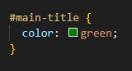
CSS-ID SELECTORS
The ID is unique and is used when you want to style only one element Each ID must be unique in the HTML document! Use IDs only when really needed!

Slide 49
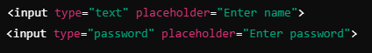
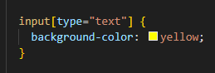
CSS-ATTRIBUTE SELECTORS
With this selector, we can target HTML elements that have a specific attribute Apply the style only to <input> elements with type="text"

Slide 50
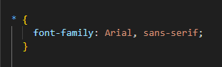
CSS-UNIVERSAL SELECTORS
Apply style to ALL elements in an HTML document Useful for resetting styles at the beginning of a CSS file!

Slide 51
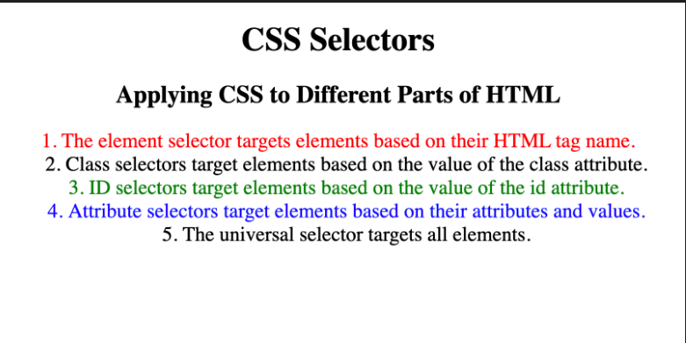
EXERCISE
Objective: Add colors using named colors, HEX, and RGB values. Steps: - Set the background-color of the page to antiquewhite. - Set the color to h1 using named colors. - Set the color for h2 using the HEX code. - Set background-color for h1 using HEX code. - Set the color for h2 using the RGB value.
Notes:
Slide 12: “CSS – Exercise 2”
Teacher Notes:
Walk through setting background-color and color using named colors, hex codes, and rgb().
Stress consistency: pick a small palette and reuse it.
Exercise estimation time: 15 min/individual
Resources:
MDN – CSS Color Values
CODE - https://github.com/dinoDuvnjak/CTK/tree/main/Bootcamp/css-uvod/2.2-css-selektori

Slide 52
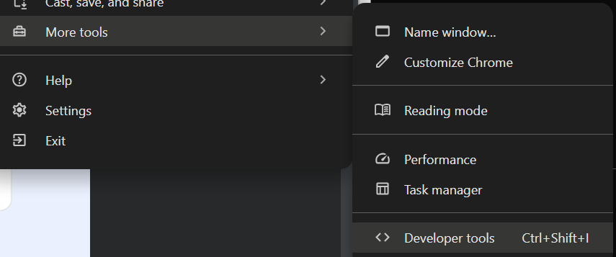
CSS-CHROME DEVELOPER TOOLS
- Enable inspection of HTML and CSS code - Detect and test CSS rules - Change live styles without changing the original code - Overview of automatically assigned browser styles
Notes:
Teacher Notes:
Slide 13 (Opening DevTools): Demonstrate all three methods (menu, shortcut, right‑click → Inspect).
Slide 14 (Computed Tab): Show how to diagnose why a style isn’t applied.
Slide 15 (CSS Overview): Use the CSS Overview panel to audit colors, fonts, and unused rules.

Slide 53
CSS-CHROME DEVELOPER TOOLS
Method 1: Via Menu - Click on the three dots in the top right corner of Chrome - More Tools → Developer Tools Method 2: Keyboard Shortcuts - Windows/Linux: Ctrl + Shift + I or F12 - Mac: Cmd + Option + I
Method 3: Right Click (Fastest!) - Right-click on any element on the web page - Click Inspect
Notes:
Teacher Notes:
Slide 13 (Opening DevTools): Demonstrate all three methods (menu, shortcut, right‑click → Inspect).
Slide 14 (Computed Tab): Show how to diagnose why a style isn’t applied.
Slide 15 (CSS Overview): Use the CSS Overview panel to audit colors, fonts, and unused rules.
Resources:
Google Developers – Chrome DevTools Overview
Chrome DevTools – CSS Overview Guide
Additional Reading:
Mastering Chrome DevTools by Jesse Cravens
Debugging with Chrome Developer Tools (Slack Engineering blog)

Slide 54

CSS-CHROME DEVELOPER TOOLS
The "Computed" tab shows the final result of all applied CSS rules. - Displays all the colors, margins, fonts, and other properties of an element - Ignores strikethrough rules that are not active - Allows you to diagnose problems faster Example: If the color of the text does not appear as you expected, you can see in the Computed section which CSS rule takes precedence.

Slide 55

CSS-CHROME DEVELOPER TOOLS
- All colors on the page (background, text, links) - What fonts are used - What font sizes are applied
Useful trick: If you see an interesting color on a web page, you can use the CSS Overview to quickly get its code and use it in your project.

Slide 56
CSS-BOX MODEL
Each HTML element consists of:
Content – Text, image, paragraph, title, etc. Padding – Inner Spacing Between Content and Border Border – A line that surrounds an element Margins – The space between an element and other elements
Notes:
Slide 16: “CSS – Box Model”
Teacher Notes:
Live‑inspect element in DevTools to show content, padding, border, and margin.
Explain how box-sizing: border-box; alters box calculations.

Slide 57


CSS-DIV ELEMENT
Sometimes it is necessary to group elements into "containers" to make it easier to add styles to them. <div> It allows flexibility in the arrangement of elements on the page.
Notes:
Teacher Notes:
Explain that <div> is a generic container; discuss semantic alternatives (<section>, <article>).
Show grouping of elements into flex or grid containers.

Slide 58

CSS-CASCADE AND SPECIFICITY
How CSS decides which style to apply when there are multiple rules for the same element
A rule that is lower in the CSS file has a higher priority and can override predefined rules. The text <li> will be blue, because the second rule comes later and overruns the first.
Notes:
Teacher Notes:
Slide 18 (Cascade): Demonstrate rule order in CSS file affecting output.
Slide 19 (Selector Priority): Walk through element → class → attribute → ID ranking.
Slide 20 (Inline Style Priority): Show inline styles beating all external/internal rules.
Slide 21 (!important): Warn about maintenance headaches—reserve for special cases only.

Slide 59

CSS-STYLE TYPE PRIORITY
The CSS specificity determines which selector takes precedence. Rules with more specifics will beat less specific ones. - Element selector (p, li, h1) - Class selector (.my-class) - Attribute selector ([type="text"]) - ID selector (#moj-id)

Slide 60


CSS-SELECTOR SPECIFICITY PRIORITY
The text will be green, as the inline style has the highest priority

Slide 61


CSS-!important RULE
If you want to make sure that a rule always applies, use !important
Excessive use of !important can complicate the maintenance of CSS. Use it only when it's necessary.

Slide 62

EXERCISE
Replicate site from image
Notes:
Teacher Notes:
Provide the reference image and challenge students to replicate layout, colors, and typography.
Encourage use of Flexbox or Grid if they wish, even though it’s not yet covered.
Exercise estimation time: 30 min/individual
CODE - https://github.com/dinoDuvnjak/CTK/tree/main/Bootcamp/css-uvod/2.3-css-cascade

Slide 63


CSS – POSITIONING
Static (default)
Relative
Elements are lined up one below the other in HTML order
The element moves 50px to the right and 50px down, but does not affect the other elements.
It doesn't move in relation to other elements, only to its original position.
Notes:
Teacher Notes:
Slide 23 (Static & Relative): Demonstrate position:relative; top/left offsets.
Slide 24 (Absolute & Fixed): Show absolute positioning within a relative parent and fixed headers.
Slide 25 (Z‑Index): Illustrate stacking context and how higher z-index brings elements forward.

Slide 64
CSS – POSITIONING
Absolute
Fixed
An element moves relative to its nearest parent, which has position:relative I- f neither parent has a postion set, then it is positioned towards the upper left corner. - Key problem with absolute: An element goes out of the normal flow of the document, so the other elements behave as if it doesn't exist.
- The element remains in the same place on the screen, even when the user scrolls. - It is used for navigation, back-to-top buttons, chat windows, etc.

Slide 65

CSS – POSITIONING
Z-index
- The z-index determines which element goes above which in the "third dimension" (Z-axis). - The higher the value of → element goes above the others.

Slide 66

EXERCISE
- Replicate site from image - Read and go through the exercises at W3 schools
Notes:
Teacher Notes:
Assign a layout mockup that requires precise positioning and layering.
Advise use of DevTools to tweak top, left, and z-index interactively.
Exercise estimation time: 25 min/individual
Resources:
CodePen – Z‑Index Playground
CODE - https://github.com/dinoDuvnjak/CTK/tree/main/Bootcamp/css-uvod/2.4-positioning

Slide 67


CSS – DISPLAY
Block
Inline
- By default, some HTML elements occupy the entire width of the page, even if their content is not wide. - Examples: <p>, <div>, <h1>, <section>, <article>, <footer>.
- These elements only take up as much space as they need. - We cannot set their width (widght) or height (height). - Examples: <span>, <a>, <strong>, <em>. - The elements will stand next to each other and ignore the width and height.
Notes:
Teacher Notes:
Slide 27 (Block vs Inline): Show how block elements stack and inline elements flow.
Slide 28 (Inline‑Block & None): Demonstrate inline‑block allowing width/height vs display:none hiding elements altogether.

Slide 68


CSS – DISPLAY
Inline block – best from both worlds
None – hiding elements
- It hides the element completely, as if it were not in HTML! - It doesn't even take up space on the schedule. - It is used for: Hide the menu until the user clicks the button. Removal of elements on the mobile versions of the site
- It combines the characteristics of block and inline elements. - It can have width and height, but does not move to a new row if there is enough space. - The elements will remain in the same row, but now we can adjust the width and height.

Slide 69


EXERCISE
- Adjust the display so that the three squares stand in the same row. - Adjust the display so that all the squares stand one below the other.
Notes:
Teacher Notes:
Provide a simple grid of three squares and ask students to toggle between row and column layouts using display.
Exercise estimation time: 30 min/individual
Resources:
CSS‑Tricks – A Complete Guide to Flexbox
CODE - https://github.com/dinoDuvnjak/CTK/tree/main/Bootcamp/css-uvod/2.5-css-display

Slide 70


CSS – FLOAT
- Float allows us to wrap text around elements, such as images, and create designs with "floating" blocks
After elements that use float, sometimes it is necessary to clean the floating effect. We use clear: both; to ensure that the elements underneath are not stuck.
Float is best for: - Wrap text around a picture
- Simple Floating Elements
Notes:
Teacher Notes:
Slide 30–31 (Float Concepts): Explain text wrapping around floated elements and why floats aren’t recommended for complex layouts.
Slide 32 (Exercise 6): Ask students to float elements in a row, then clear the float for elements below.

Slide 71


CSS – FLOAT
Good practice
Bad practice
- Float is NOT a recommended technique for complex layouts. - Better to use Flexbox and CSS Grid.

Slide 72

EXERCISE
- Adjust the display so that the three squares stand in the same row. - Adjust the display so that all the squares stand one below the other.
Notes:
Exercise estimation time: 30 min/individual
CODE - https://github.com/dinoDuvnjak/CTK/tree/main/Bootcamp/css-uvod/2.6-css-float

Slide 73


CSS – RESPONSIVNESS
CSS Grid
Flexbox
Desktop → Two columns Mobile → Single Column
Desktop → Elements are OK (horizontal) Mobile → Elements are stacked vertically
- It allows you to create complex layouts using rows and columns. - CSS Grid is powerful for complex layouts and allows us to easily control the widths and heights of elements.
- Flexbox is great for navigation menus, buttons, and in-line arrangement of elements.
Notes:
Teacher Notes:
Slide 33 (Flexbox & Grid): Compare use cases—Flexbox for one‑dimensional layouts, Grid for two‑dimensional.
Slide 34 (Bootstrap, Tailwind, Bulma, Kendo): Show code snippets from each and discuss trade‑offs between custom CSS vs utilities/frameworks.

Slide 74

CSS – RESPONSIVNESS
Bootstrap
Alternatives
- TAILWIND CSS
- BULMA
- KENDO
Desktop → 2 columns (50% - 50%) Mobile → Automatically moves to 1 column
- Bootstrap provides ready-made styles and predefined classes for a simple design without a lot of coding

Slide 75


CSS – FINAL EXERCISE
Enhance Your CraftEase Workshop Management Website with CSS and Responsive Design
Add CSS Styling:
Improve the look and feel of your CraftEase workshop management website by adding custom CSS styles
Create a professional, modern design that reflects the home improvement retail industry
Ensure that the design is visually appealing, consistent, and builds trust with DIY enthusiasts
Use appropriate colors, typography, and spacing that align with workshop and retail branding
Use a Responsive Framework:
To make development easier and ensure responsiveness, use any popular framework like Bootstrap, Bulma, Tailwind CSS, or any other framework of your choice
Leverage the framework's components to create professional-looking workshop cards, forms, and data tables
Utilize grid systems to organize your workshop listings, participant information, and inventory displays effectively
Notes:
Teacher Notes:
Clearly restate project requirements: styling, responsiveness, framework use, GitHub deployment.
Offer a checklist and rubric for grading (visual design, code quality, responsiveness, version control).
Exercise estimation time: 1 h/individual
Resources:
GitHub Guides – Hello World
FreeCodeCamp – Responsive Web Design Certification
CODE - https://github.com/dinoDuvnjak/CTK/tree/main/SHIFT4IT/css-introduction/3-final-exercise

Slide 76
CSS – FINAL EXERCISE
Ensure Full Responsiveness:
The website should be fully responsive, adapting seamlessly to mobile phones, tablets, and desktop screens
Workshop registration forms should be easy to fill out on mobile devices
Participant tables and inventory data should be readable and accessible on smaller screens
Navigation should work smoothly across all device sizes for both customers and store staff
Optimize the layout and elements to provide a smooth user experience for DIY workshop participants browsing on different devices
Design Considerations for DIY Retail:
Use colors and design elements that reflect the home improvement and crafting industry
Make workshop cards visually appealing with clear information hierarchy
Ensure forms are user-friendly for customers registering for workshops
Create clear visual distinction between different workshop types and skill levels
Make inventory status easily scannable for store staff

Slide 77
CSS – FINAL EXERCISE
Update on GitHub:
Once the improvements are complete, commit and push the updated code to your GitHub repository
Update your README.md file to include screenshots of the responsive design
Document the framework choice and any custom CSS features you implemented
Ensure all CSS files are properly organized and linked

Slide 78


CSS – FINAL EXERCISE

Slide 79
MDN – CSS First Steps
MDN – Cascade and Inheritance
MDN – Specificity
MDN – Using !important
MDN – The <div> Element
CSS: The Definitive Guide by Eric A. Meyer (box model chapter)
Google Developers – Chrome DevTools Overview
Chrome DevTools – CSS Overview Guide
Mastering Chrome DevTools by Jesse Cravens
Debugging with Chrome Developer Tools (Slack Engineering blog)

Slide 80
MDN – CSS Positioning
Frontend Mentor Challenges
MDN – Z‑Index
CSS Secrets by Lea Verou (positioning techniques)
CSS Mastery by Andy Budd
MDN – CSS Selectors
W3Schools – CSS Selectors Reference
MDN – Float

Slide 81
CSS‑Tricks – A Complete Guide to Floats
Learning Web Design by Jennifer Niederst Robbins (float chapter)
Responsive Web Design by Ethan Marcotte
MDN – Flexbox
MDN – Grid
Bootstrap Documentation
Tailwind CSS Documentation
Bulma Documentation

Slide 82
https://developer.mozilla.org/en-US/docs/Learn/Getting_started_with_the_web/CSS_basics
https://www.w3schools.com/css/css_intro.asp
https://developer.mozilla.org/en-US/docs/Web/HTML/Global_attributes/style
https://developer.mozilla.org/en-US/docs/Web/HTML/Element/style
https://developer.mozilla.org/en-US/docs/Web/HTML/Element/link
https://developer.mozilla.org/en-US/docs/Web/CSS/color_value
https://developer.chrome.com/docs/devtools/
https://developer.chrome.com/docs/devtools/css/

Slide 83
https://codepen.io/una/pen/VwKxZp
https://css-tricks.com/snippets/css/a-guide-to-flexbox/
https://guides.github.com/activities/hello-world/
https://www.freecodecamp.org/learn/responsive-web-design/

Slide 84
JAVASCRIPT
The language that drives the web

Slide 85
SUMMARY
- JavaScript powers websites with interactivity and dynamic content.
- Where it works:
- Frontend: Manipulates HTML/CSS, creates animations.
- Backend: Node.js runs JavaScript on servers.
- Mobile: React Native builds apps.
- Integration Approaches:
- Inline and internal scripts (less optimal).
- External scripts (preferred for performance and organization).

Slide 86
SUMMARY
- Core Concepts:
- Variables: let (block scope), var (function scope, hoisting).
- Data Types: String, Number, Boolean.
- String Methods: length, slice().
- Math Operations: Order of operations, parentheses.
- Functions: Reusable code with parameters and return values.
- Conditions & Logic: if, else, ===, logical operators.
- DOM Manipulation: Selecting and changing HTML/CSS dynamically.
- Best Practices:
- Use let over var to avoid bugs.
- Keep scripts external.
- Follow consistent naming and code style.

Slide 87
JAVASCRIPT
JavaScript is the most popular programming language according to research (e.g., RedMonk, Stack Overflow surveys). - Frontend – HTML/CSS manipulation, animations, UI/UX improvements. - Backend – Node.js allows JavaScript to run on servers. - Mobile apps – React Native allows you to develop mobile apps using JavaScript.
- Java vs JavaScript? – They have about as much in common as the emperor (car) and carpet. - JavaScript is an interpreted language – It is executed line by line in the browser. - Java is a compiled language – It is first compiled into an executable file, then it is run. - Why "Java" in JavaScript? – In the 90s, the name Java was popular, so Netscape took advantage of that popularity.
Notes:
Teacher Notes:
Highlight JavaScript’s ubiquity: front‑end (DOM manipulation, animations), back‑end with Node.js, and cross‑platform mobile with React Native.
Contrast interpreted (JS) vs. compiled (Java) languages and explain why JS was named for marketing in the 90s.

Slide 88



JAVASCRIPT – FIRST STEPS
We can use double ("") or single ('') quotation marks for text. Recommendation: Double quotes for text data in JavaScript. Developers should follow the same writing styles for readability.
Notes:
Teacher Notes:
Discuss coding styles: single versus double quotes, semicolon usage, naming conventions.
Recommend adopting a style guide (Airbnb, Google) and using linters (ESLint).
Resources:
Airbnb JavaScript Style Guide – github.com/airbnb/javascript
ESLint – eslint.org

Slide 89


JAVASCRIPT – INTEGRATION
Internal Javascript
Inline Javascript
Bad practice! Difficult to maintain and debugging. It's inseparable from HTML.
Better than inline JavaScript, but still not optimal for larger projects.
Notes:
Teacher Notes:
Inline: <button onclick="…"> – quick tests but poor maintainability.
Internal: <script> in the page head/body – central per‑page, but duplicates across pages.
External: <script src="app.js" defer> – best practice for caching and separation of concerns; explain defer/async.

Slide 90


JAVASCRIPT – INTEGRATION
Extern Javascript
- The JavaScript will run before the HTML is loaded. - If the script tries to change HTML elements that have not yet been loaded, we will get an error.
- Better code organization - Easier maintenance - Better performance - Allows caching, which speeds up page loading - The page works faster by displaying the content first, then running javascript

Slide 91






JAVASCRIPT – INTEGRATION
Exercise
String
Numbers
Boolean (true/false)
- They allow us to use the data in the program correctly. - They prevent errors – we cannot, for example, add a string and a number:
How the browser recognizes
Notes:
Teacher Notes:
Cover primitive types (String, Number, Boolean, null, undefined, Symbol, BigInt) and Objects.
Demonstrate type coercion pitfalls ('5' + 2 === '52' vs. 5 + +'2' === 7).

Slide 92




JAVASCRIPT – VARIABLE
- They allow data to be reused without repeating the code. - They help organize the program. - They allow you to customize and change data during program execution.
Exercise
Declaration
Change in value
Notes:
Teacher Notes:
Introduce var, let, and const. Recommend defaulting to const, then let for reassignable variables.
Show examples of redeclaration and scope differences in a live REPL.
Resources:
MDN Web Docs – var, let, and const
JavaScript Info – Let and Const

Slide 93


JAVASCRIPT – VARIABLE
VAR
LET
Variables defined using var are available within the entire function in which they are declared, even before the declaration itself.
Variables defined using let are only available within the block {} in which they are defined.
Notes:
Teacher Notes:
Explain function vs. block scope. Demonstrate Temporal Dead Zone (TDZ) when accessing let/const before declaration.
Show how var is hoisted with an example.
Resources:
MDN Web Docs – Scope
JavaScript Info – Hoisting

Slide 94




JAVASCRIPT – VARIABLE
VAR
LET
VAR is "hoisted" to the top of its function, but initialized as undefined.
let is also raised, but it is not initialized, so if you access it before declaring, you get a ReferenceError.
VAR allows the same variable to be redeclared within the same scope.
let does not allow re-declaration within the same scope.

Slide 95

JAVASCRIPT – VARIABLE NAMING
VAR
LET
VAR becomes a property of the window object.
let it doesn't.
Use let instead of var to better control the reach and avoid unexpected behavior due to hoisting.

Slide 96



JAVASCRIPT – LENGTH
- length tells us how many characters a string has. - Useful for checking character limits (e.g. for tweets)
Code commenting
Notes:
Teacher Notes:
Use str.length to enforce limits (e.g., Twitter‐style 140‑character checks).
Walk through a prompt/alert exercise that counts remaining characters.
Resources:
MDN Web Docs – String.prototype.length

Slide 97

Write a code that: - It allows the user to enter text. - Calculates the number of characters. - Shows how many characters are left (max: 140).
Notes:
Exercise estimation time: 15 min/individual

Slide 98


JAVASCRIPT – SLICE
- slice(start, end) takes the part of the string from start to end (not including end). - It is useful for limiting entries (e.g. the number of characters in a tweet)
Example of how to draw the last character
Notes:
Teacher Notes:
Demonstrate slice(start, end), including negative indices, to truncate text.
Build on the length exercise by slicing text over 140 characters and displaying via alert().
Resources:
MDN Web Docs – String.prototype.slice()

Slide 99

Write a code that: - It allows the user to enter text. - Shorten text to 140 characters. - Display shortened text using alert().
Notes:
Exercise estimation time: 15 min/individual

Slide 100



JAVASCRIPT – MATHEMATICS
Mathematicians operators
Sequence of operations
- First, multiplication * and division / are performed, then addition + and subtraction - If we want to change the order, we use parentheses ().
Notes:
Teacher Notes:
Review +, -, *, /, % and the default precedence; show how parentheses alter evaluation.
Example exercise: prompt user for input (e.g., dog years → human years formula) and alert() result.
Resources:
MDN Web Docs – Arithmetic operators
Additional Reading:
Programming JavaScript Applications by Eric Elliott

Slide 101
Write a code that: 1. Prompt input from the user using prompt(). 2. Calculate the human years according to the formula. 3. Display the result using alert().
Notes:
Exercise estimation time: 15 min/individual

Slide 102


JAVASCRIPT – FUNCTIONS
- We use it to avoid repeating the code. - We call her only when we need her
Notes:
Teacher Notes:
Define a function with function name(params){…} and explain DRY (Don’t Repeat Yourself).
Exercise: replace an alert() with console.log() via a simple function call.
Resources:
MDN Web Docs – Functions

Slide 103

Write a code that: 1. Returns the text shown below as a log instead of an aler
Notes:
Exercise estimation time: 15 min/individual

Slide 104


JAVASCRIPT – FUNCTIONS
- Parameters allow a function to receive input and use it within its code - Without parameters, the function always works the same – with parameters we can change its outcome!
Notes:
Teacher Notes:
Show how parameters make functions reusable (e.g., calculate bottles of milk at $1.50 each).
Distinguish side‑effect functions (no return) vs. pure functions (with return value).
Resources:
MDN Web Docs – Function parameters
MDN Web Docs – return

Slide 105

- The function should receive the amount of money. - Calculates how many bottles of milk you can buy (1 bottle = $1.5). - It shows how many bottles he can buy.
Notes:
Exercise estimation time: 15 min/individual

Slide 106


JAVASCRIPT – FUNCTIONS
- Return allows the function to return a value that can be used later. - The No Return function performs an action, but does not return any result.

Slide 107

- The function receives the amount of money. - Calculates how many bottles of milk he can buy (1 bottle = $1.5). - Returns change (money left over after purchase).
Notes:
Exercise estimation time: 15 min/individual

Slide 108




JAVASCRIPT – FUNCTIONS
By combining multiple functions, we improve the organization of the code!

Slide 109


JAVASCRIPT – CONDITIONS
One condition
Multiple conditions
- Conditions allow you to control the flow of the program - We can create advanced logics
Notes:
Teacher Notes:
Conditions: if / else, switch for control flow.
Comparators: === vs. ==, <, >, etc., and pitfalls of coercion.
Logical Operators: &&, ||, !, short‑circuit behavior for defaults.
Resources:
MDN Web Docs – Control flow and error handling
MDN Web Docs – Comparison operators
Additional Reading:
Effective JavaScript by David Herman
You Don’t Know JS: Types & Grammar by Kyle Simpson

Slide 110



JAVASCRIPT – COMPARATORS
Always use === for precise checks
By combining comparison operators, we can make more complex logic.

Slide 111




JAVASCRIPT – LOGICAL OPERATORS
Logical operators allow you to check multiple conditions at once.

Slide 112

JAVASCRIPT – DOM
Document object model
- DOM is a website model that allows JavaScript to modify HTML and CSS in real-time. - When the page loads, the browser converts HTML into a DOM object that we can select and manipulate.
Notes:
Teacher Notes:
Explain how the browser parses HTML into a tree of nodes that JS can traverse and manipulate.
Show document global and basic node types (Element, Text, Comment).
Resources:
MDN Web Docs – Introduction to the DOM
Additional Reading:
DOM Enlightenment by Cody Lindley

Slide 113

JAVASCRIPT – DOM
- Allows you to change HTML elements (text, color, content...) - Interaction with the user (clicks, typewriter, input fields...) - Automate changes without refreshing the page
Notes:
Teacher Notes:
Demonstrate selecting elements via getElementsByTagName or querySelectorAll.
Exercise: select the third <li> and change its text to your name without editing the HTML.
Resources:
MDN Web Docs – Document.querySelectorAll()

Slide 114



JAVASCRIPT – DOM
Changing HTML Elements
changing CSS styles
simulates click na checkbox.

Slide 115
Select the third <li> element and change its text to your name (WITHOUT changing the HTML)!
Notes:
Exercise estimation time: 15 min/individual

Slide 116



JAVASCRIPT – DOM
querySelector() and querySelectorAll() are the most powerful because they can select IDs, classes, and tags at the same time.
Notes:
Teacher Notes:
Cover querySelector() for complex CSS‑style selectors.
Exercise: change the color of a “Google” link dynamically via JS.
Resources:
MDN Web Docs – Element.querySelector()

Slide 117
Change the color of the Google link using JavaScript
Notes:
Exercise estimation time: 15 min/individual

Slide 118
JavaScript Task: Add Form Validation and Dynamic Participant Management
Objective
Enhance your existing CraftEase HTML foundation by adding JavaScript functionality for form validation and dynamic participant management. You'll transform the static workshop registration system into an interactive web application.
Requirements
Feature 1: Workshop Registration Form Enhancement
Real-time form validation with custom error messages
Dynamic workshop details that update based on selected workshop type
Age validation (minimum 16 years for workshops)
Email format validation with visual feedback
Form submission handling with success/error messages
Notes:
Teacher Notes:
Set clear requirements: dynamic form handling, delete buttons, live filtering, input validation, and GitHub deployment.
Encourage use of event listeners (addEventListener), DOM updates (appendChild, removeChild), and basic error handling.
Exercise estimation time: 45 min/individual
Resources:
MDN Web Docs – Introduction to events
freeCodeCamp – JavaScript DOM Manipulation Projects
CODE - https://github.com/dinoDuvnjak/CTK/tree/main/SHIFT4IT/javascript-introduction/4.1-final-exercise

Slide 119
Feature 2: Interactive Participant Management
Add new participants dynamically to the table without page refresh
Search and filter participants by name or workshop type
Delete participants with confirmation dialog
Edit participant status (Confirmed, Waitlist, Cancelled)
Deliverables
Enhanced HTML file with JavaScript integration
Working form validation with real-time feedback
Dynamic participant management without page refresh
Clean, commented JavaScript code
GitHub repository with updated project
Notes:
Teacher Notes:
Set clear requirements: dynamic form handling, delete buttons, live filtering, input validation, and GitHub deployment.
Encourage use of event listeners (addEventListener), DOM updates (appendChild, removeChild), and basic error handling.
Exercise estimation time: 45 min/individual
Resources:
MDN Web Docs – Introduction to events
freeCodeCamp – JavaScript DOM Manipulation Projects
CODE - https://github.com/dinoDuvnjak/CTK/tree/main/SHIFT4IT/javascript-introduction/4.1-final-exercise

Slide 120
MDN Web Docs – Introduction to JavaScript
“State of JS” survey results (e.g. RedMonk & StackOverflow)
Eloquent JavaScript by Marijn Haverbeke
You Don’t Know JS (book series) by Kyle Simpson ​
https://github.com/rwaldron/idiomatic.js – JAvascript code convetion.
MDN Web Docs – JavaScript data types and data structures
JavaScript Info – Types, values, objects
MDN Web Docs – <script> element
Google Developers – Loading JS Efficiently
You Don’t Know JS: Types & Grammar by Kyle Simpson

Slide 121
Effective JavaScript by David Herman
You Don’t Know JS: Types & Grammar by Kyle Simpson
DOM Enlightenment by Cody Lindley
You Don’t Know JS: Async & Performance by Kyle Simpson
Professional JavaScript for Web Developers by Nicholas C. Zakas

Slide 122
https://developer.mozilla.org/en-US/docs/Web/JavaScript/Reference/Statements/var
https://javascript.info/variables
https://developer.mozilla.org/en-US/docs/Glossary/Scope
https://javascript.info/hoisting
https://developer.mozilla.org/en-US/docs/Web/JavaScript/Reference/Global_Objects/String/length
https://developer.mozilla.org/en-US/docs/Web/JavaScript/Reference/Global_Objects/String/slice
https://developer.mozilla.org/en-US/docs/Web/JavaScript/Reference/Operators/Arithmetic_Operators

Slide 123
https://developer.mozilla.org/en-US/docs/Web/JavaScript/Guide/Functions
https://developer.mozilla.org/en-US/docs/Web/JavaScript/Reference/Functions/parameters
https://developer.mozilla.org/en-US/docs/Web/JavaScript/Reference/Statements/return
https://developer.mozilla.org/en-US/docs/Web/JavaScript/Guide/Control_flow_and_error_handling
https://developer.mozilla.org/en-US/docs/Web/JavaScript/Reference/Operators/Comparison_Operators
https://developer.mozilla.org/en-US/docs/Web/API/Document_Object_Model/Introduction
https://developer.mozilla.org/en-US/docs/Web/API/Document/querySelectorAll
https://developer.mozilla.org/en-US/docs/Web/API/Element/querySelector

Slide 124
MOBILE DEVELOPMENT
ANDROID AND IOS

Slide 125
SUMMARY
Native Development:
- Android: Android Studio with Java/Kotlin, app lifecycle management, and Material Design.
iOS: Xcode with Swift/Objective-C, iOS design standards, and lifecycle events.
Cross-Platform Development:
- Use a unified codebase to build apps for Android and iOS.
- Benefits:
- Faster development and updates.
- Lower costs and easier maintenance.
- Consistent user experience.
- Access to native features via plugins/APIs.

Slide 126
SUMMARY
Popular Frameworks:
- React Native (JavaScript/React):
- High performance.
- Reusable components.
- Hot reload.
- Flutter (Dart):
- Custom rendering engine.
- Highly customizable widgets.
- Compiles to native code.
- Apache Cordova (HTML/CSS/JavaScript):
- Wraps web apps in a native container.
- Large plugin ecosystem.
- Lower performance than fully native.

Slide 127
MOBILE DEVELOPMENT - NATIVE
Android:
- Development Tools: Familiarity with Android Studio and the use of Java or Kotlin.
- App Lifecycle and UI Design: Understanding Android-specific design guidelines and the lifecycle of an Android app.
iOS:
- Development Tools: Using Xcode with Swift (or Objective-C) for app development.
- Design Principles: Adhering to iOS design standards and managing app lifecycle events.
Notes:
Teacher Notes:
Android: Demonstrate creating a “Hello World” app in Android Studio using Kotlin, then walk through the Android Activity lifecycle (onCreate, onPause, onDestroy).
iOS: Show an Xcode SwiftUI project, emphasizing the App lifecycle and the Swift Package Manager for dependencies.
Discuss platform design guidelines (Material for Android, Human Interface for iOS) and why adhering to them improves UX.
Resources:
Android Developers – App Fundamentals
Apple Developer – App Architecture
Additional Reading:
Android Programming: The Big Nerd Ranch Guide by Bill Phillips & Chris Stewart
iOS Programming: The Big Nerd Ranch Guide by Christian Keur & Aaron Hillegass

Slide 128
MOBILE DEVELOPMENT – CROSS-PLATFORM
Developing natively for both Android and iOS can be time-consuming and resource-intensive. Cross-platform development allows you to use a unified codebase to reduce costs, accelerate development, and improve maintainability — without sacrificing performance or user experience.
Building apps for multiple platforms from a single codebase offers several key benefits: - Faster time-to-market with reduced development effort. - Lower development and maintenance costs. - Consistent user experience across platforms. - Ability to leverage native features using plugins and APIs. - Easier updates and feature rollouts.
Notes:
Teacher Notes:
Compare costs and timelines for maintaining two native codebases vs. one cross‑platform codebase.
Highlight real‑world examples: how Airbnb transitioned from native to React Native for faster feature delivery.
Resources:
Microsoft – Cross-platform Mobile Development Overview
Smashing Magazine – “Cross‑Platform Mobile App Development: Pros and Cons”

Slide 129
MOBILE DEVELOPMENT – CROSS-PLATFORM
Unified Codebase
Instead of maintaining two separate codebases for Android (Java/Kotlin) and iOS (Objective-C/Swift), cross-platform frameworks enable developers to write code once and run it on both platforms.
Example:
- Write a login feature in React Native → Works on both iOS and Android
- Shared business logic, network requests, and data handling
- Consistent behavior across platforms
Consistency
Maintaining a consistent UI and user experience across platforms is critical for user retention and satisfaction.
Example:
- Material Design components on Android → Cupertino components on iOS
- Cross-platform frameworks automatically adapt UI to platform guidelines
- Platform-specific gestures (like swiping or haptic feedback) handled by the framework
Notes:
Teacher Notes:
Overview of Cross-Platform Development
Cross-platform development allows developers to build mobile applications using a single codebase and deploy them on multiple platforms (Android, iOS). This reduces development effort and ensures consistency in functionality and user experience.
Unified Codebase
Instead of maintaining two separate codebases for Android (Java/Kotlin) and iOS (Objective-C/Swift), cross-platform frameworks enable developers to write code once and run it on both platforms.
Use a code demo: write a simple login screen in React Native and show it running on Android emulator and iOS simulator from the same code.
Explain how shared business logic (e.g., API calls) resides in a single JS module.
Resources:
React Native – Getting Started
Expo – React Native Tools
Additional Reading:
Learning React Native by Bonnie Eisenman
React Native in Action by Nader Dabit

Slide 130
MOBILE DEVELOPMENT – TOOLS
Apache Cordova
- Language: HTML, CSS, JavaScript
- Approach: Wraps a web app in a native container using WebView
- Plugins: Allows access to native device features (camera, GPS)
Advantages:
- Familiar web technologies
- Large ecosystem of plugins
Considerations:
- Web-based approach → Lower performance than native
- UI elements may not feel "native"
- Shared business logic, network requests, and data handling
- Consistent behavior across platforms
Notes:
Teacher Notes:
Demo installing Cordova CLI (npm install -g cordova), creating a project (cordova create), and adding platforms (cordova platform add android).
Show how to access device features (camera, geolocation) via plugins (cordova plugin add cordova-plugin-camera).
Resources:
Apache Cordova – Getting Started Guide
GitHub – Apache Cordova Plugins
Additional Reading:
Apache Cordova in Action by Raymond Camden & John Wargo
PhoneGap Essentials by John M. Wargo

Slide 131
MOBILE DEVELOPMENT – TOOLS
React Native
- Language: JavaScript + React
- Approach: Uses native components and a JavaScript bridge
- Hot Reload: Fast updates without rebuilding the app
Advantages:
- High performance → Close to native
- Strong community and third-party libraries
- Reusable UI components
Considerations:
- Complex animations and UI may require native modules
- Learning curve for handling state and props
Notes:
Teacher Notes:
Demo installing Cordova CLI (npm install -g cordova), creating a project (cordova create), and adding platforms (cordova platform add android).
Show how to access device features (camera, geolocation) via plugins (cordova plugin add cordova-plugin-camera).
Resources:
Apache Cordova – Getting Started Guide
GitHub – Apache Cordova Plugins
Additional Reading:
Apache Cordova in Action by Raymond Camden & John Wargo
PhoneGap Essentials by John M. Wargo

Slide 132

MOBILE DEVELOPMENT – TOOLS
Flutter
- Language: Dart
- Approach: Uses a custom rendering engine for building UI
- Hot Reload: Fast updates without full rebuild
Advantages:
- High performance → Compiles to native code
- Highly customizable UI with widgets
- Growing community and strong Google support
Considerations:
- Dart is less familiar to most developers
- Larger app size compared to other frameworks
Notes:
Teacher Notes:
Show a flutter create demo, run on emulator, then edit a widget and see hot reload.
Explain the widget tree concept and how Flutter’s custom rendering bypasses native UI components for full control.
Resources:
Flutter – Get Started
Dart – Language Tour
Additional Reading:
Flutter in Action by Eric Windmill
Beginning Flutter: A Hands On Guide to App Development by Marco L. Napoli

Slide 133
EXERCISE
Pack and Deploy Your CraftEase Workshop Management Website with Apache Cordova - Install Apache Cordova Set up Cordova on your machine to package your HTML, CSS, and JavaScript files into a mobile-ready application. - Prepare Your Web Project Make sure your project folder is well-structured and includes all necessary files (HTML, CSS, JS). - Build the Mobile App Use Cordova commands to build your project for Android or iOS, creating native app packages. - Test on Real Devices Install the generated app files on your phone or emulator to see your classroom management tool in action.
- Once the improvements are complete, commit and push the updated code to your GitHub repository
https://cordova.apache.org/
Notes:
Teacher Notes:
Provide a live walkthrough packaging the Classroom Management web app via Cordova: cordova build android and deploying to a device.
Emphasize testing on both Android and iOS emulators or real devices and debugging via remote WebView inspector.
Exercise estimation time: 60 min/individual
Resources:
Apache Cordova – Debugging Guide
Android – Debug WebView on Android Devices

Slide 134

MOBILE DEVELOPMENT – FINAL EXERCISE
Notes:
Teacher Notes:
Provide a live walkthrough packaging the Classroom Management web app via Cordova: cordova build android and deploying to a device.
Emphasize testing on both Android and iOS emulators or real devices and debugging via remote WebView inspector.
Resources:
Apache Cordova – Debugging Guide
Android – Debug WebView on Android Devices

Slide 135
Flutter – Get Started
Dart – Language Tour
Flutter in Action by Eric Windmill
Beginning Flutter: A Hands On Guide to App Development by Marco L. Napoli
Apache Cordova – Getting Started Guide
GitHub – Apache Cordova Plugins
Apache Cordova in Action by Raymond Camden & John Wargo
PhoneGap Essentials by John M. Wargo

Slide 136
React Native – Getting Started
Expo – React Native Tools
Learning React Native by Bonnie Eisenman
React Native in Action by Nader Dabit
Microsoft – Cross-platform Mobile Development Overview
Smashing Magazine – “Cross‑Platform Mobile App Development: Pros and Cons”

Slide 137
https://developer.android.com/guide/components/fundamentals
https://developer.apple.com/documentation/appkit/app_architecture
https://reactnative.dev/docs/getting-started
https://expo.dev/
https://flutter.dev/docs/get-started
https://dart.dev/guides/language/language-tour
https://cordova.apache.org/docs/en/latest/guide/cli/
https://github.com/apache/cordova-plugins

